Slide 1
Measurement – Area
Miss Lum
Year 11 Essentials

Slide 2

Learning Outcomes
1.3.5 Choose and use appropriate metric units of area, their abbreviations and conversions between them
1.3.6 Estimate the areas of different shapes
1.3.7 Convert between units of area and other area units
1.3.8 Calculate areas of rectangles, trianles, and composite shapes

Slide 3
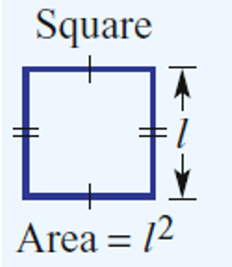
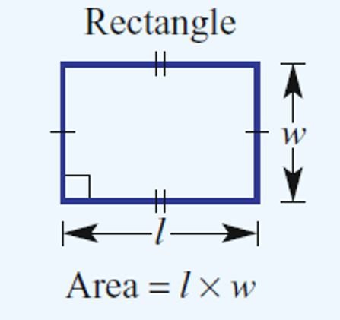
24
7
30
Area
Date: /03/2018
EQ – How do we find the area of rectangles and squares?
The area of a two-dimensional shape is a measure of the space it occupies.
Area Formulas

Slide 4
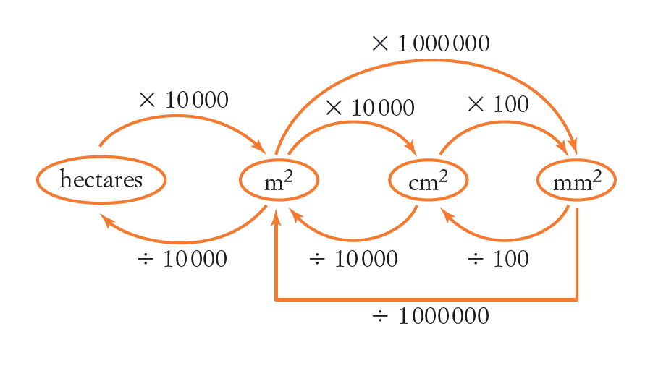
24
7
30
Area
Date: /03/2018
EQ – What are the units of measurement for area?
The units of measurement for area are mm², cm², m², and hectares to list a few common ones. There are many more.
Converting Between Units of Measurements of Area

Slide 5

Task
Converting Metric Units of Length and Area Time Trial

Slide 6
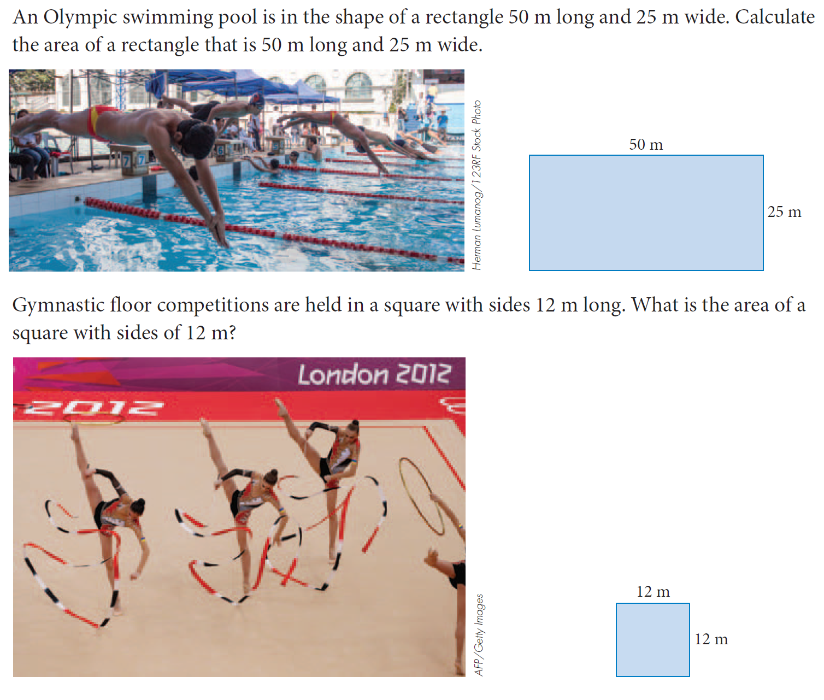
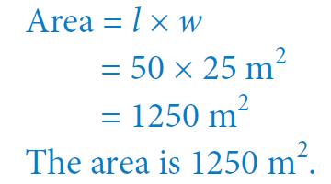
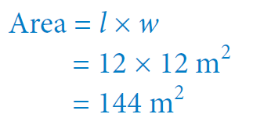
Example

Slide 7
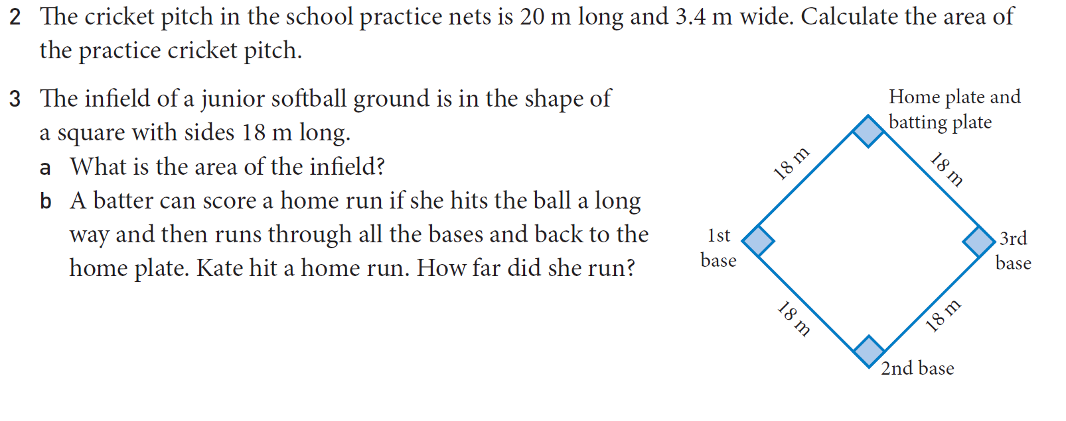
Task

Slide 8
Task
MAWA Essentials Maths, Questions 1 – 7, p 47

Slide 9
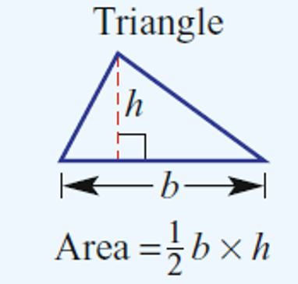
24
7
30
Area
Date: /03/2018
EQ – How do we find the area of triangles?
Area Formula

Slide 10
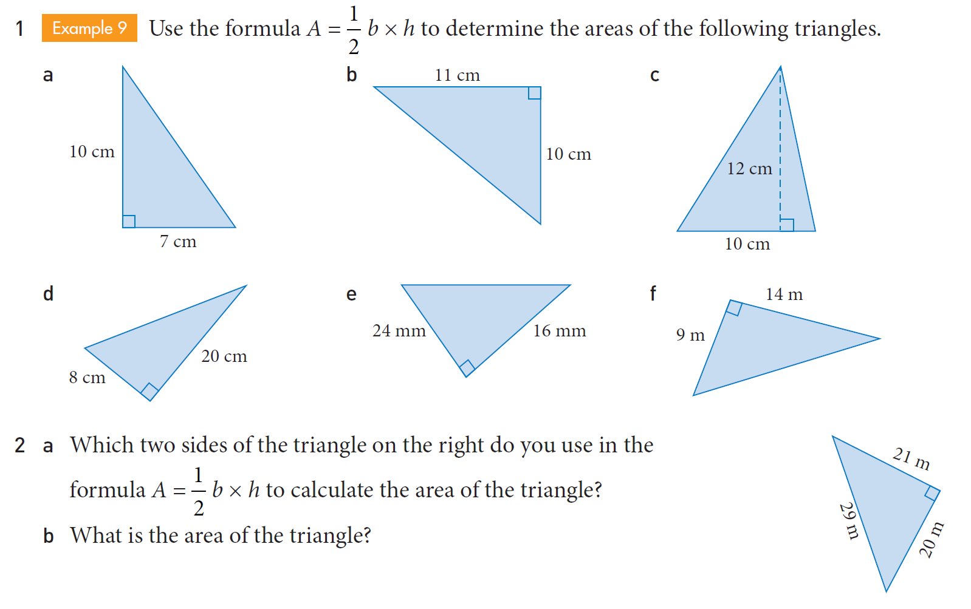
Task

Slide 11
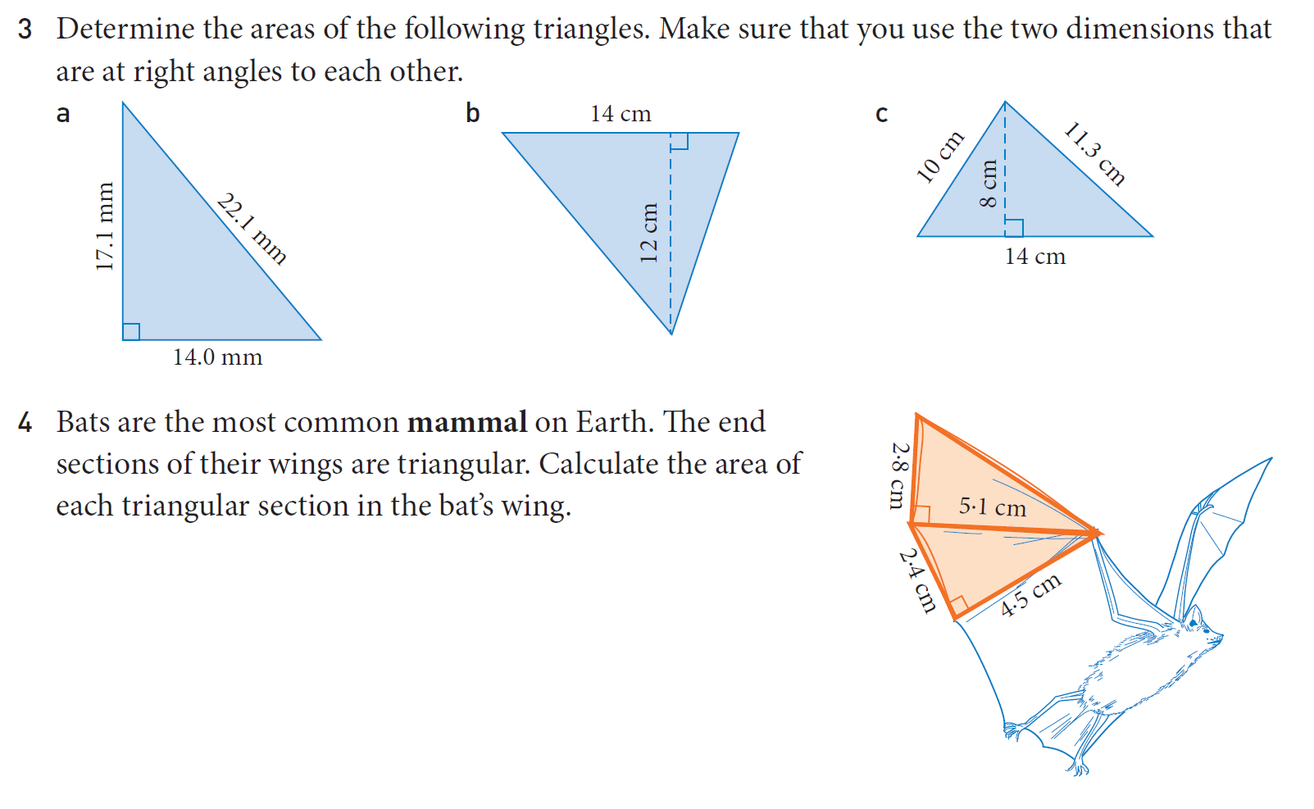
Task

